Slide 1


CITS1003 Introduction to Cybersecurity Risks and Controls

Slide 2
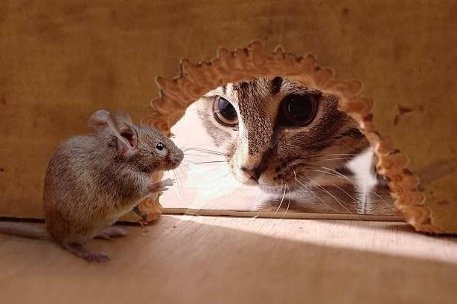
A unit about cats cybersecurity

Slide 3
Assessing Risk
Risk Is the probable frequency and probable magnitude of future loss from a threat acting on a vulnerability
Qualitative
Quantitative
In both cases, need to understand:
The business itself
Assets of organisation
Threat analysis
Vulnerability assessment

Slide 4
Qualitative Risk Assessment
Uses a variety of techniques to assess risk
Brainstorming
Delphi technique: anonymous question and answer technique
Storyboarding
Focus groups
Surveys/Questionnaires
Checklists
Can help in communication of risks but difficult to prioritise based on the range of values

Slide 5
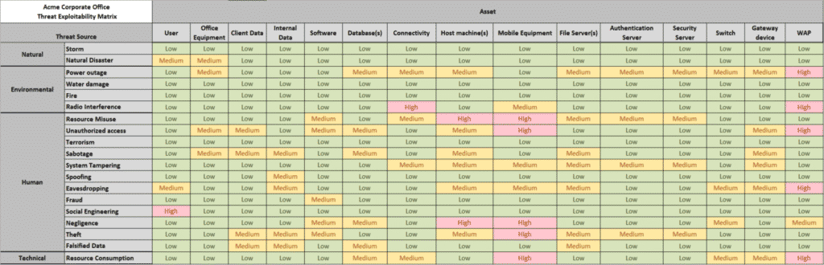
Qualitative Risk Assessment

Slide 6
Quantitative Risk Assessment
Asset Valuation AV
Exposure Factor EF %
Single Loss Expectancy SLE = AV * EF
Annualized Rate of Occurrence ARO %
Annualized Loss Expectancy ALE
Cost/Benefit of countermeasures

Slide 7
Example
You own an iPhone 12 which costs AU $1,349. If you drop the phone and the screen breaks, the cost of repair is AU $850. You have dropped your phone on average once every 2 years
AV = $1,349
Exposure Factor = 0.63
Single Loss Expectancy = $850
Annualized Rate of Occurrence = 0.5
Annualized Loss Expectancy = 0.5 * 850 = $425
Apple Care+ costs $199 for 3 years and $45 per incident for screen replacement
Annualized cost of insurance = $67 + $45 * 0.5 if there is an incident = $92
$425 > $92 and so insurance is worth it

Slide 8
Risk Treatment: Part 1
Once risks have been identified, they can be:
Reduced or mitigated
Use controls to reduce risk
Assigned or transferred
Transfer to a third party such as a cloud provider
Use cyberinsurance
Accepted
Accept the potential losses
Deterred
Try and avoid the risk by using deterences such as policies and warnings, security cameras, guards, fences, auditing etc

Slide 9
Risk Treatment: Part 2
Avoided
Change the business so that the risk is avoided. e.g. choose a different supplier or provider
Rejected or ignored
Don’t accept the risk as being credible (dangerous move)

Slide 10
Controls
Controls are applied to mitigate cybersecurity risk
Types:
Physical
Technical
Administrative
Functions
Preventative
Detective
Corrective

Slide 11
Technical Controls
Technical, or logical, controls are the use of hardware or software to manage access provide protection to assets
Examples include:
Authentication methods
Encryption
Anti-malware software
IDPS
Firewalls

Slide 12
Administrative Controls
Organisation’s policies and procedures defined by its security policies
Focus on personnel and business practices
Examples include:
Hiring practices
Security screening
Data classification and labelling
Security awareness training

Slide 13
Physical Controls
Physical controls that prevent, monitor or detect unauthorised access to assets
Examples include
Lock systems
CCTV
Swipe cards
Mantraps
Alarms

Slide 14
Preventive Controls
A control that aims to stop an incident from occurring or reduce the probably frequency of the risk.
Examples include ﻿locks, biometrics, alarm systems, separation of duties, data classification, penetration testing, access-control methods, encryption, auditing, security policies, security-awareness training, anti-malware software, firewalls, and IPS

Slide 15
Deterrents
Deterrents discourage violation of security policies through visible warnings and consequences for violators
Examples include ﻿security-awareness training, locks, fences, security badges, guards, mantraps, and security cameras.

Slide 16
Detective Controls
Detective controls are concerned with detecting or discovering malicious activity during or after it has occurred
Examples include audit trails, logging, IDS, honeypots (and honeynets), CCTV

Slide 17
Corrective Controls
Corrective controls are concerned with reducing the negative impact of the risk by allowing affected systems to recover after an incident has occurred
Examples include recovering from backups, resetting compromised accounts

Slide 18
Control Examples
 |  | Control Functions
 |  | Preventative | Detective | Corrective
Control Types | Physical | Fences, gates, locks | CCTV and surveillance camera logs | Repair physical damage, re-issue access cards
 | Technical | Firewall, IPS, MFA, AV | IDS, Honeypots | Patching, Reboot systems, Quarantine malware
 | Administrative | Hiring and Firing practices, Separation of Duties, Data Classification | Review access rights, audit logs, review unauthorised changes | Implement Business Continuity Plan, Incident response plan

Slide 19
Security Operations : Part 1
Need-to-know and Least Privilege
Aim is to keep secrets secret
Grant users and systems access only to data and resources they need for their specific duties
Separation of duties and responsibilities
Never put a single person in charge of an entire function
Includes putting cybersecurity responsibilities outside of IT
Don’t want the people implementing systems also checking them
Two-person control, Job rotation, mandatory vacations,
Privileged account management
Change management

Slide 20
Security Operations: Part 2
Personnel security
Security awareness training
Mobile device management
Working from home
Information management lifecycle
Creation, storage, use, archiving, destruction and purging
Hardware and software
Asset management
Protection of physical assets
Machine rooms: access, cooling and fire prevention
Virtual assets
Licensing and Software License Agreements

